Slide 1

Enhancing Wifi Security in an IoT network
Name: Girish Dyal
Student ID: 2012046
BSc Computer Science level 3
Supervisor: Dr. Avinash Mungur
PROBLEM DEFINITION
As the number of IoT devices continues to grow, the attack surface for hackers also increase
Lack of proper security mechanism in IoT device has made them easy targets for hackers
The limited resources of IoT devices makes it challenging to implement strong security measures
In a local network, IoT devices and traditional computers are connected to the same central access point. This makes the IoT devices exposed to anyone that may have access to the local network, subsequently increasing their security risks
There are authentication or encryption solutions that are implemented but this does not really solve the issue

Slide 2

Aims and Objectives
Aims:
Construct a smart home IoT system where IoT devices are in a star topology
Protect communication of IoT devices by isolating them from the main network
Ensuring the power requirements of devices are preserved
Only IoT devices can wirelessly connect to the IoT gateway
Ensure that only authorize device can manage the IoT devices
Objectives:
To enhance the Wi-Fi security of IoT devices by segmenting the local network
Create separate network for each group
Set up a password-protected gateway with WPA2 protocols
Configure switch to create VLANs & router to create logical interfaces for VLANs
Configure password parameters on both switch and router
Project Scope
Reduce attack surface
Better access control to resources and data
Easier for network administrators to monitor network traffic

Slide 3
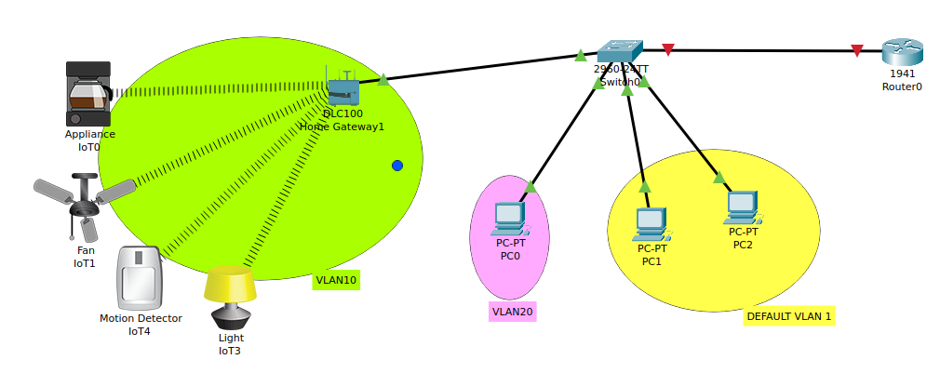

Proposed Solution
Isolating all the IoT devices from the main network
Creating separate virtual networks by using VLANs on switch
Design an IoT topology that segments the network based on device types
Allow only authorized users to monitor IoT devices
Design
Tool used

Slide 4


Project progress
Background study along with a review of the critical points of current knowledge
Analysis and requirements of the system
Designing the topology of the system
Implementing the system
Conclusion & Introduction of the thesis
Evaluation of the system
Testing the system

